Slide 1
Creating a JSF-enabled Web Application

Slide 2
Configuration
Tomcat 8 or 9,
Java 8,
JSF 2.2

Slide 3
Steps
Configure Tomcat
Create a Maven project
Run a Simple WebApp on Tomcat
Run a Simple JSF Application on Tomcat

Slide 4
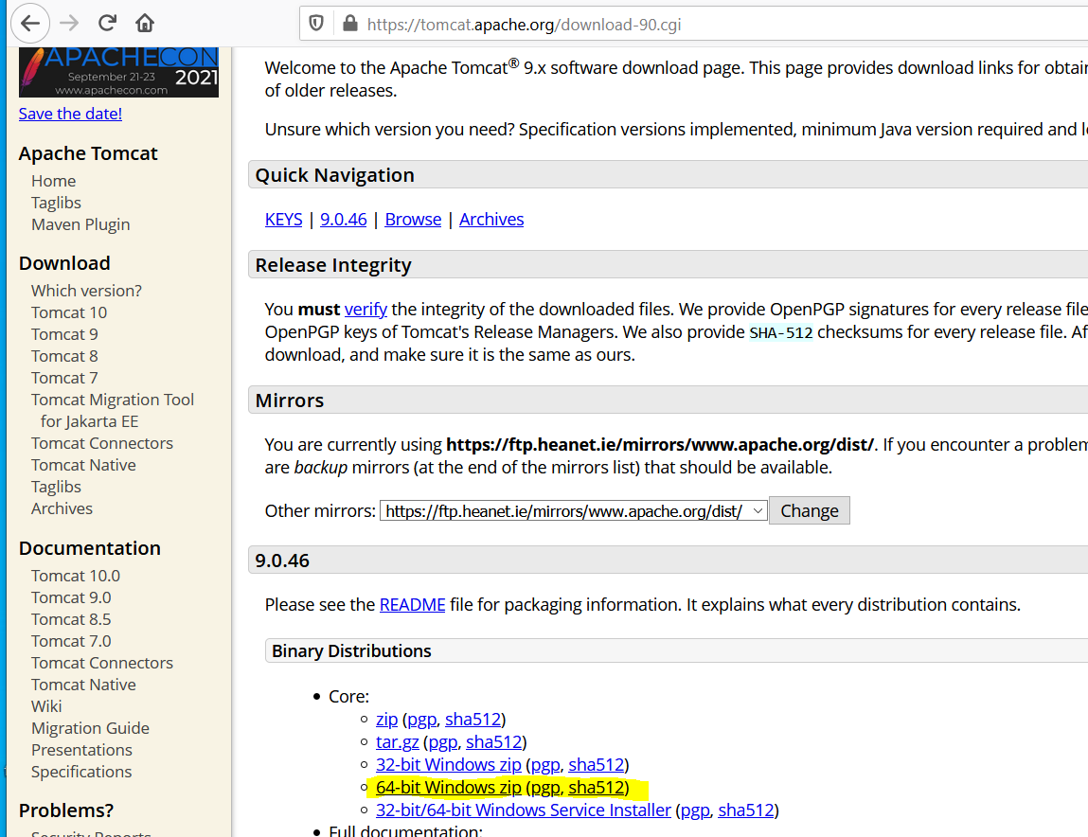
Configuring Tomcat
Download Tomcat 8 or 9 and unzip it.
See video #1.Configure Tomcat

Slide 5
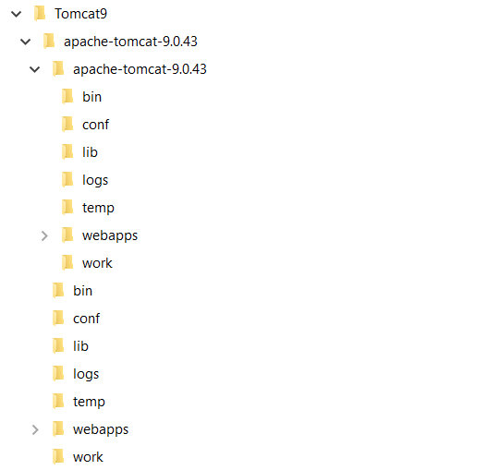
Configuring Tomcat
Download Tomcat 8 or 9 and unzip it.
See video #1.Configure Tomcat

Slide 6
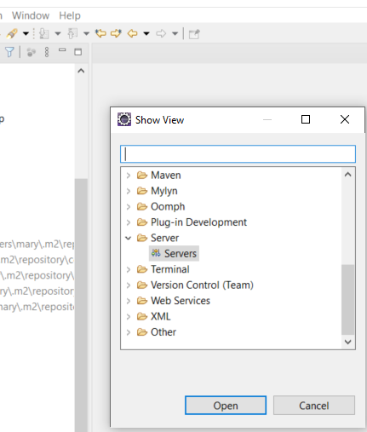
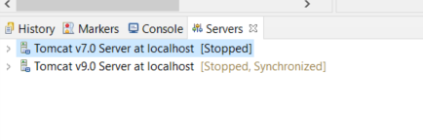
Configuring Tomcat
Open the server view in Eclipse
Initially no servers will be displayed here
See video #1.Configure Tomcat

Slide 7
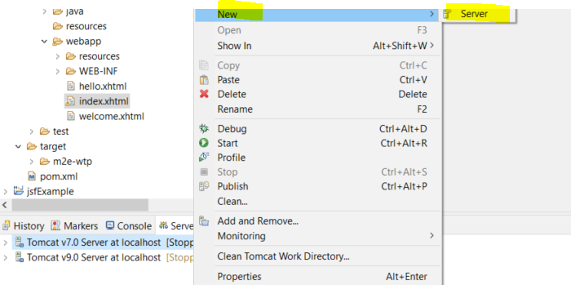
Configuring Tomcat
Right Click on Server window and
See video #1.Configure Tomcat

Slide 8
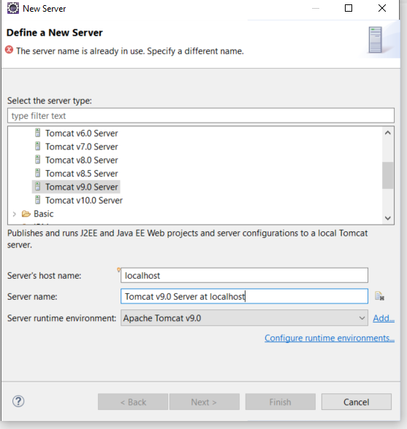
Configuring Tomcat
Select the Server type and Next
See video #1.Configure Tomcat

Slide 9
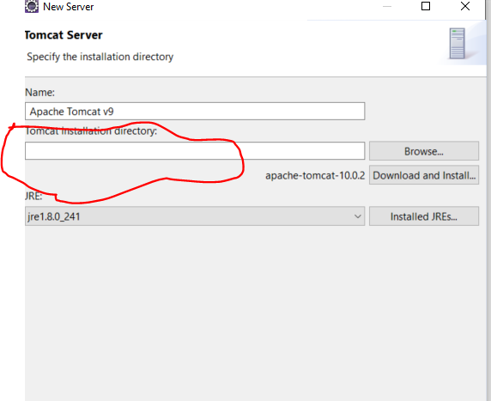
Configuring Tomcat
The Tomcat Installation directory is where you unzipped Tomcat
See video #1.Configure Tomcat

Slide 10
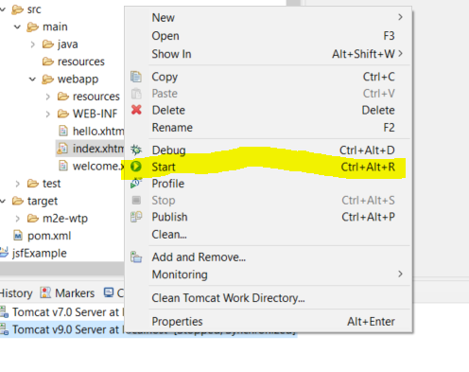
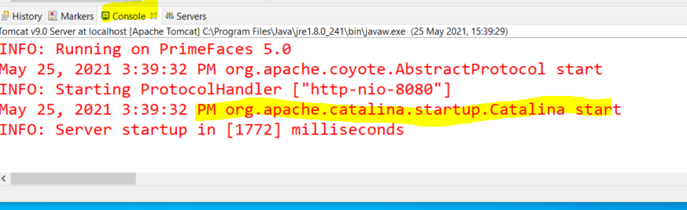
Configuring Tomcat
Starting the server. Right Click on the server and “Start”. Check the console output. Make sure the server starts.
See video #1.Configure Tomcat

Slide 11
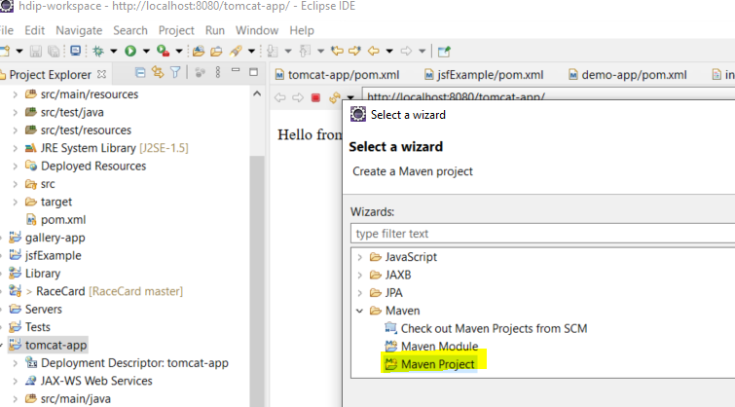
Create a Simple Maven Project
File -> New -> Maven Project
See video #2.MavenDeploy

Slide 12
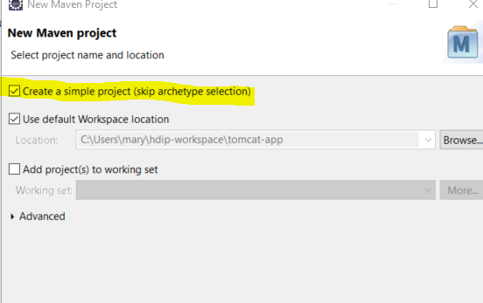
Create a Simple Maven Project
Skip archetype selection
See video #2.MavenDeploy

Slide 13
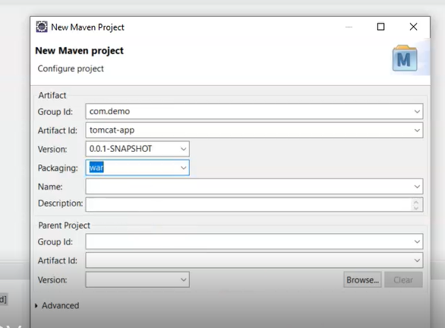
Create a Simple Maven Project
Choose packaging type war
See video #2.MavenDeploy

Slide 14
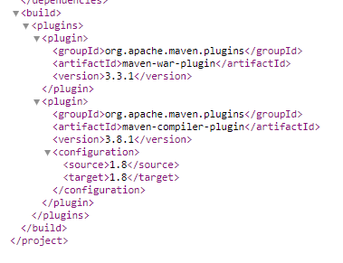
Create a Simple Maven Project
pom.xml is available on Moodle
See video #2.MavenDeploy

Slide 15
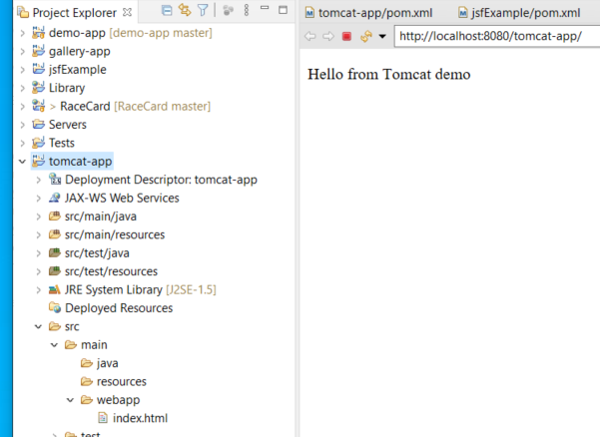
Create a Simple Maven Project
Add .html file into the webapp folder and Run on Server.
See video #2.MavenDeploy

Slide 16
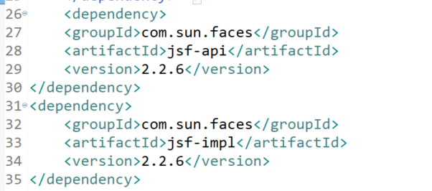
Create a JSF Application
Note pom.xml from tomcat-app includes two dependencies.
See video #3. JSF Application

Slide 17
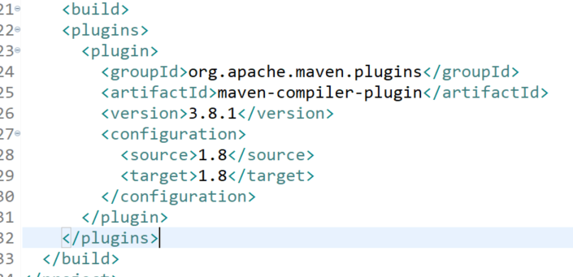
Create a JSF Application
Update the pom.xml from tomcat-app to change the build
See video #3. JSF Application

Slide 18
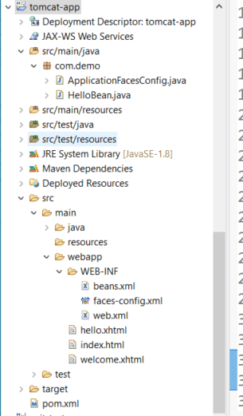
Create a JSF Application
Add the folder WEB-INF into webapp and drop in the files beans.xml, faces-config.xml and web.xml.
See video #3. JSF Application

Slide 19
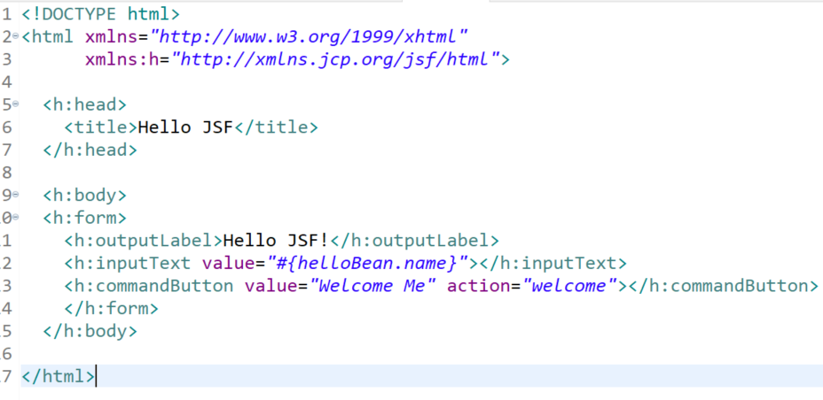
Create a JSF Application
Add the files hello.xhtml and welcome.xhtml
See video #3. JSF Application

Slide 20
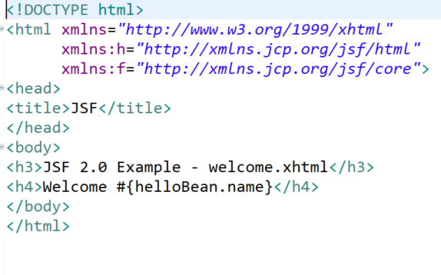
Create a JSF Application
Add the files hello.xhtml and welcome.xhtml
See video #3. JSF Application

Slide 21
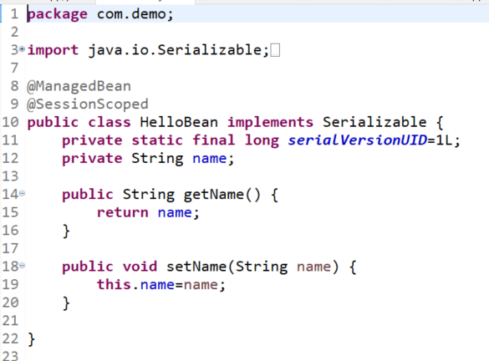
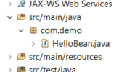
Create a JSF Application
In the java folder, create a package called com.demo and add the file HelloBean.java
See video #3. JSF Application

Slide 22
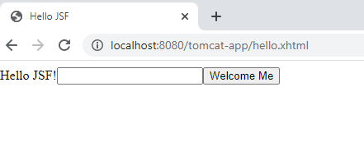
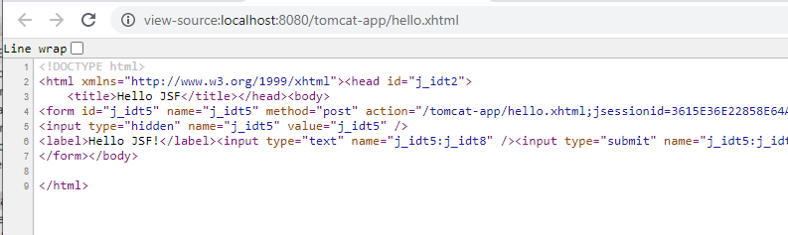
Create a JSF Application
Run the project on the Server
View Page Source
See video #3. JSF Application

Slide 23
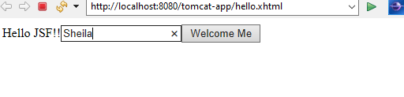
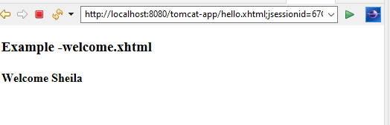
Create a JSF Application
Run the project on the Server
See video #3. JSF Application

